Slide 1
Welcome to e-Advantzware
E-Business
24 Hour Real Time
Customer / Support Access

Slide 2
E-Business Overview
E-Advantzware software has been developed with WEB SPEED, a registered trademark of Progress Software Corporation. Web Speed is both a fourth generation language and web development tool for building and deploying business applications across corporate intranets, extranets and the internet utilizing XML. High throughput, sub-second transaction times, and dynamic load balancing enable unsurpassed scalability to handle thousands of simultaneous users, while optimizing transaction processing for proven reliability and application data integrity.
The e-business and Internet information processing industry is full of choices. The more software vendors involved in the process, the more difficult it will be to resolve problems such as security, workstation response time, integration into the corporate database, connectivity between web applications and corporate systems and more. This uncertainty is the exact reason why we selected a proven vendor, Progress Software Corporation, with a track record in both large corporate database design, communications and Internet connectivity. Progress is a world leader in the database market with a customer list that includes more than 60 percent of the
Fortune 500.

Slide 3
E-Business Overview
WEBSPEED consists of the Web Speed Development Workshop and the Webs Speed Transaction Server. The development workshop is an integrated suite of development tools, which speed the process of building Internet transaction processing (ITP) applications either locally or remotely over the web. The Web Speed Transaction Server is a robust platform for deploying and processing internet based applications with high scalability and lights out response times. Record locking, transaction rollback, and two-phase commit allow Web Speed to safeguard application and data integrity, even if transactions are interrupted. This guarantees the integrity of transactions that may span multiple databases.
Because the future is uncertain, Progress makes all Advantzware software modules “Future Proof” applications in regard to both portability and scalability. As companies grow, acquire new companies, add warehouses and provide their customers access over the Internet, Advantzware must support new users as efficiently as before. Especially when offering applications over extranents or the Internet, Advantzware must handle an unpredictable, even exponential growth in on-line users. With the strength of Progress, your data can grow to 150 gigabytes and when your users jump from 10 to 10,000, you can still rely on the same performance. In addition, our software can be migrated across a broad range of hardware and software platforms including SCO, Unix, Windows, Windows NT, Windows 2000, Citrix and the new Linux, which is quickly becoming the Internet’s dominant operating system. Your software investment is protected now and in the future.

Slide 4

E-Business Overview
E-Advantzware Internet based e-business Software..
Progress Web Speed Transaction Server - The Progress Web Speed transaction server provides an optimized transaction-processing environment to help you achieve high transaction volumes and rapid responses for Web applications. With high throughput, sub-second transaction times, and dynamic load balancing, you get unsurpassed scalability to handle thousands of simultaneous users. Record locking, transaction rollback, and two-phase commit allow Web Speed to safeguard application and data integrity, even if transactions are interrupted, and guarantee the integrity of transactions that span multiple databases. Other features include compatibility to XML and HTML based applications, message queuing to improve agent availability, automatic starting web speed agents during peak loads, Name Server for location transparency, load balancing and redundancy and an open architecture to integrate third party security solutions such as firewall, authentication, authorization and encryption technologies.

Slide 5
E-Business Overview
E-Request for Quotes - Customer requests for quotes may be processed over the Internet, whereby the customer submits the basic box specifications. The customer enters the requested quantities, due date, box style, inside length, width, depth, number of colors, board material and special notes. Our friendly software makes this process easy with the aid of on-line lookups on each field including a pop up picture of each box style. Once submitted, an e-mail confirmation alerts the sales/service department, who transfer the quote request to estimating. Once the estimate is calculated, a quote is generated, wired to your customer complete with an e-mail confirmation. Your company saves data entry time and money and your customer is impressed with your service.

Slide 6
E-Business Overview
E-Order Entry - Customers may place new orders over the Internet for custom boxes, stock boxes, supplies or may release inventory from previously entered orders. The customer may search items by part number or description to add to their on-line shopping cart. To place an order for a custom box, the customer simply enters the quote number, purchase order and due date and the e-order is immediately added to the Advantzware corporate database. Orders for stock boxes or supplies do not require the quote number, therefore order entry is simply a matter of adding items to the shopping cart, then confirming the order. To release warehoused items from previously created just in time orders, the customer will select the purchase order number and part numbers to be released followed by the due dates, release quantity and shipping destination. Once the order has been submitted, an order acknowledgment is e-mailed as an order confirmation. Once again, your company saves data entry time and money and your customer is impressed with your service.

Slide 7
E-Business Overview
E-Account History - Your customer can check his account history at any time to view their outstanding invoices, payment history, check numbers and more.
E-Sales Service – Customers may check order status, inventory levels, release dates and delivery status while logged onto the web without the need for your customer service. They can search by purchase order number, part number or description and a list of orders and items will appear for their review. Again, you save time, money and your clients are happy.

Slide 8
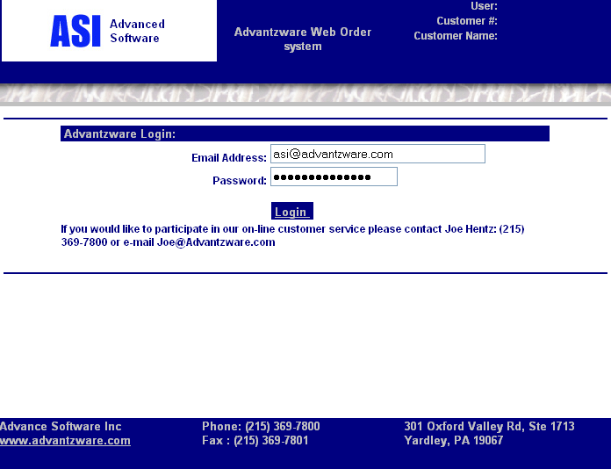
Login Screen
Login identification provides the default for access to each
e-Advantzware module.

Slide 9
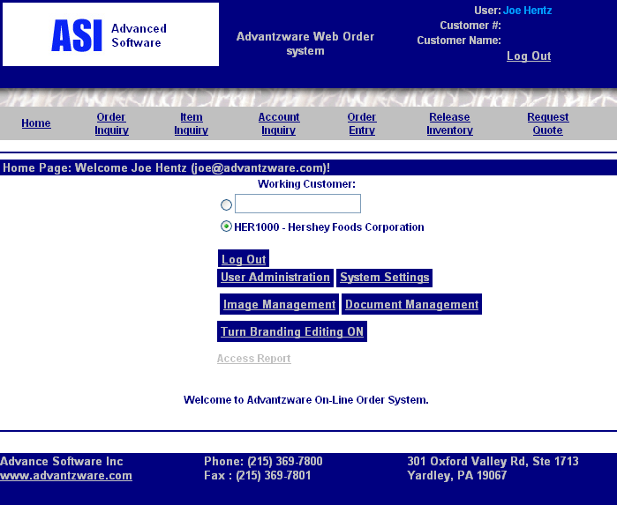
User Administrator Main Menu
System administrator has access for defining maintenance files.

Slide 10
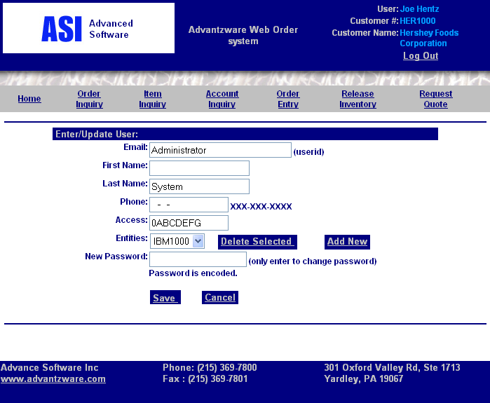

Slide 11
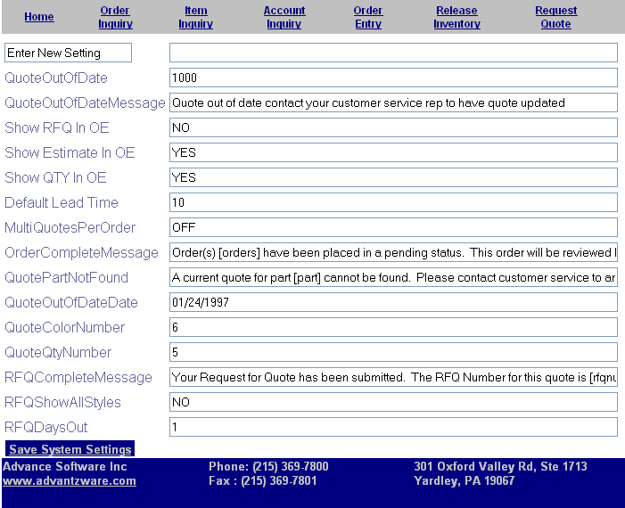
System Settings
Default setting and use of the software is maintained via system settings. Email messages are defined in your terminology to provide friendly messages too your customers. Access to existing quotes based on days old may be blocked and standard due dates , colors and more may be define.

Slide 12
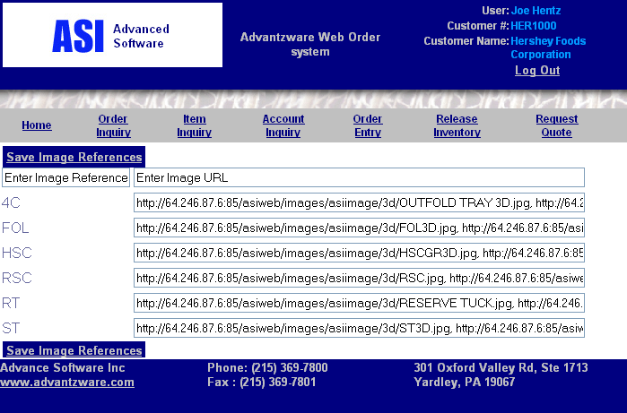
Images Management
Box style 3D images are displayed for customers to view during the request for quote module. Valid images are defined in the Advantzware box system.

Slide 13
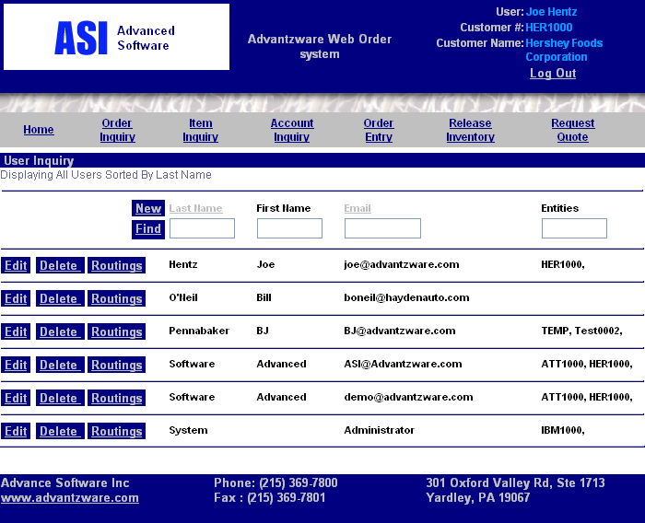
User Administration
Administration menu provides the ability to define which customers have access to what data. Therefore, your sales representatives may have access to all client’s data over the Internet. They can view order details at the clients office via the web.

Slide 14
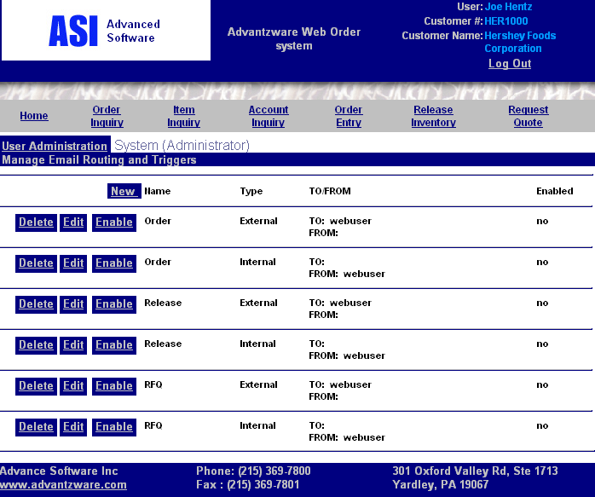
User Administration
User Routings
An email distribution list may be ordered for incoming and outgoing correspondence when using the
e-advantzware software.

Slide 15
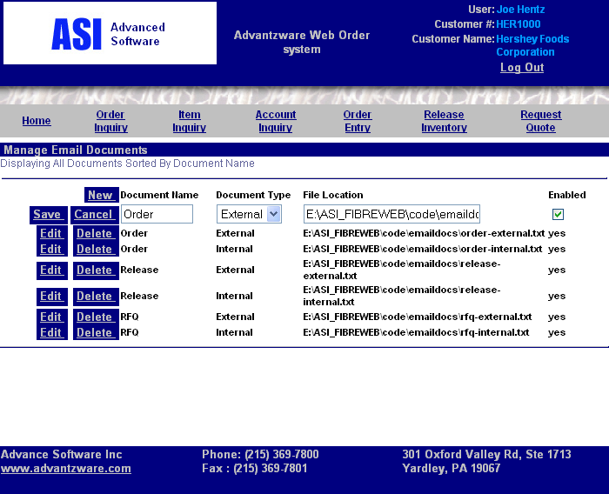
User Administration
User Routings
When orders, releases and request for quotes are processed, an email alert and email confirmation are sent to the
pre-defined distribution list.

Slide 16
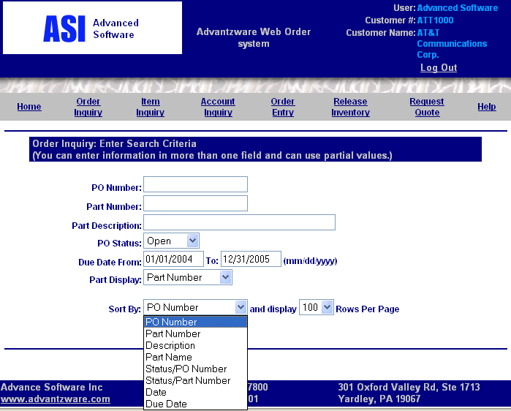
Order Inquiry
All Orders
The customer service module provides numbers options to find specific orders. The search button will show all orders by open, closed order, pending or all statuses. Orders may be sorted by PO number, part number, description, part name, status, date and due date.

Slide 17
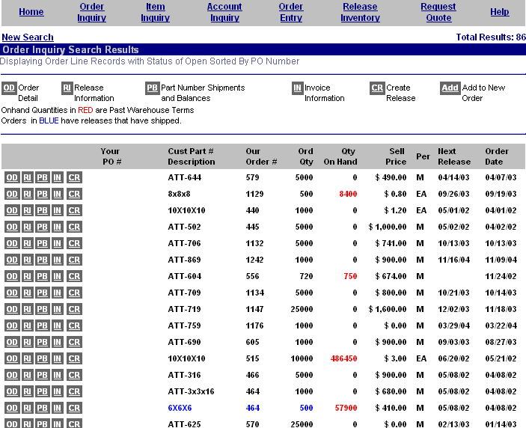
Order Inquiry
All Orders
Once the orders have been sorted a list will appear for additional drill down options. orders in RED are past the contracted warehouse terms and should be shipped and/or invoiced. Each order line may be added to a new order or viewed to show order details, scheduled releases,
part number balances and invoice status. Plus, actual deliveries may be released On-line.

Slide 18
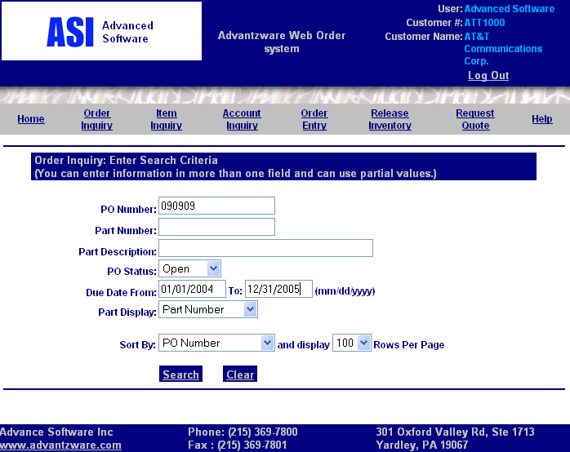
Order Inquiry
By Purchase Order
Customer can view a specific order by entering specific data regarding the orders such as the purchase order number.

Slide 19
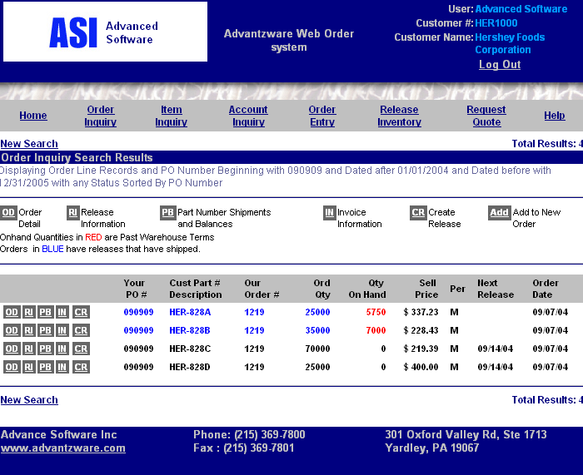
Order Inquiry By Purchase Order
All items on the order appear for further inquiry. The block menu items provide further details by order, release, part number and invoice information.

Slide 20
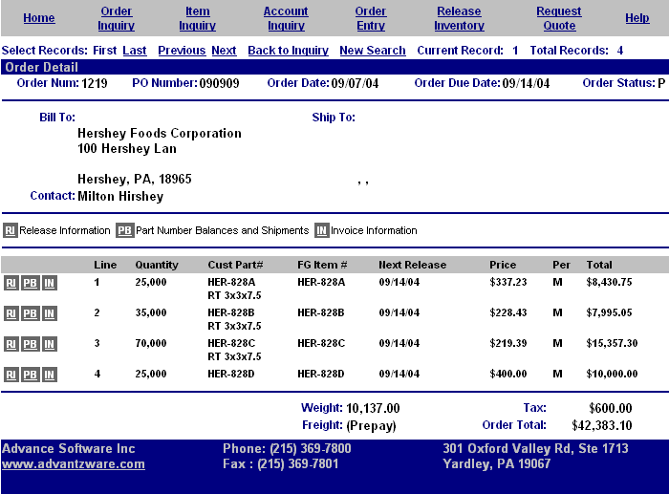
Order Inquiry
Order Detail
The order detail customer ship to order shows the quantity, item, code, sell price and totals.

Slide 21
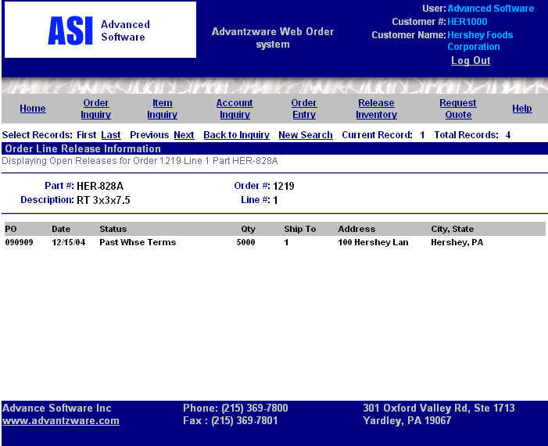
Order Inquiry
Release Information
Scheduled releases shows the delivery data, purchase order number and quantity to ship. Delivery status may be on time, late, back ordered or past warehouse terms, hence ready to be invoiced.

Slide 22
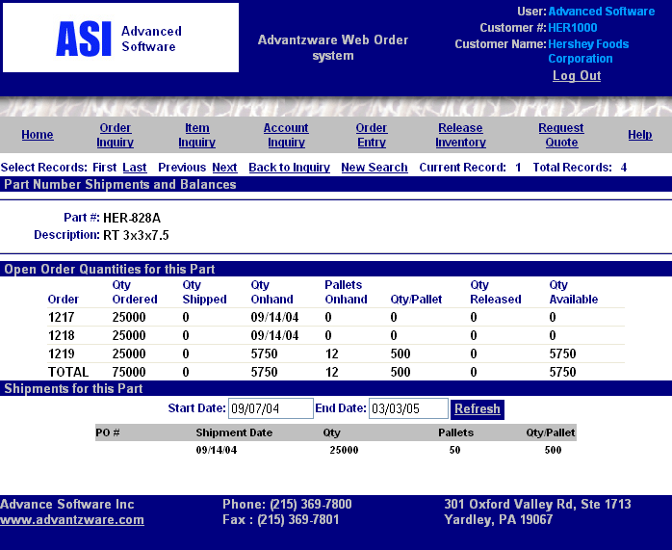
Order Inquiry
Part Number Shipments
Each customer part number shows Inventory balances for each order. Delivery dates may also be viewed.

Slide 23
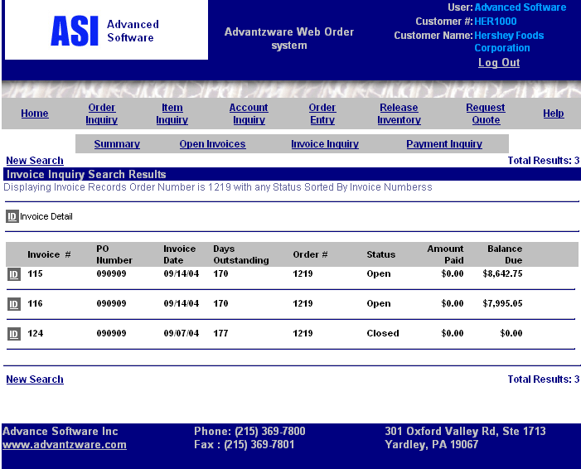
Order Inquiry
Invoice Information
Invoice information may be viewed for each order number showing invoice number, purchase order number, date aged days, status and balance due. Summary, detail and payment history is also available.

Slide 24
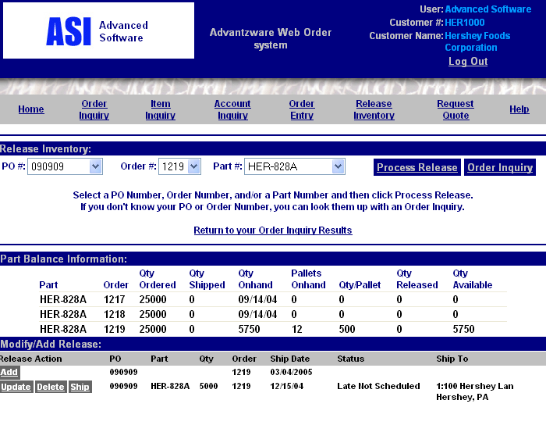
Order Inquiry
Create Release
Scheduled deliveries may be added, deleted, and updated at any time 24 hours a day 7 days a week. More free time for customers service.

Slide 25
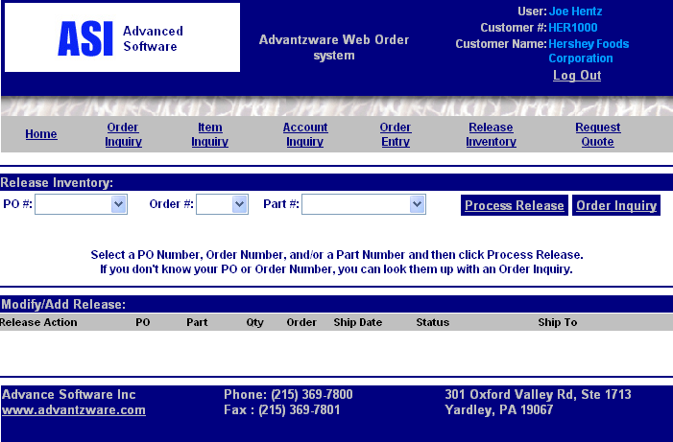
Release Inventory
Customer may create releases for delivery from the inquiry or directly from the release inventory folder. Customers may enter a specific purchase order number, or order number and/or part number to schedule a delivery.

Slide 26
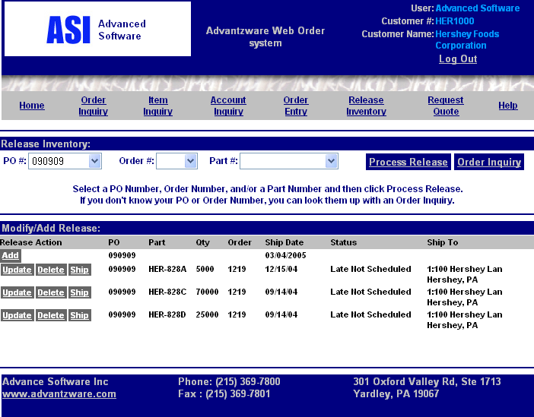
Release Inventory
Scheduled deliveries may be added, deleted, And updated at any time 24 hours a day 7 days a week. More free time

Slide 27
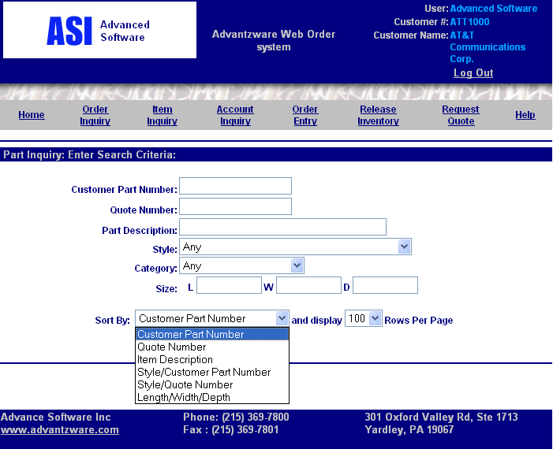
Item Inquiry
The customer part numbers inquiry list may be sorted by part number, quote number, item description, style, length, width and depth. Likewise, specific part numbers, quotes, description, styles, category and size may be searched.

Slide 28
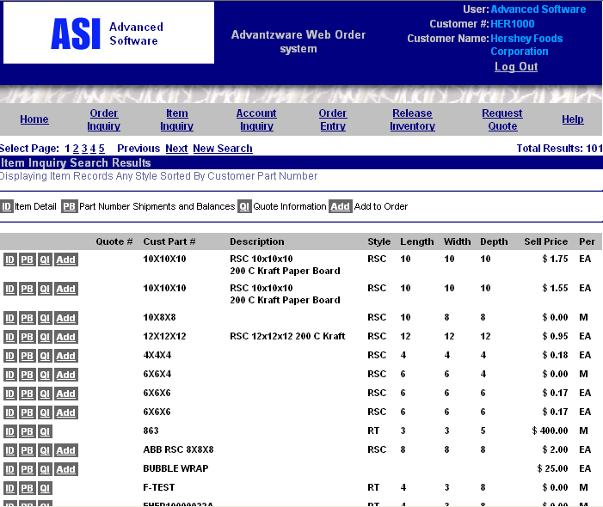
Item Inquiry Search Information

Slide 29
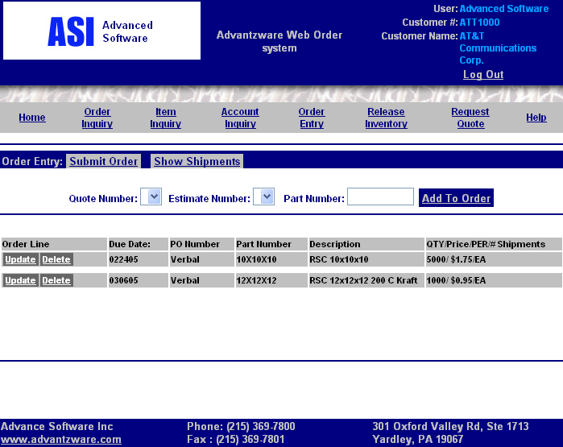
Order Entry
Order entry will show only quotes and estimates that are valid according to the age of the quote and estimate.

Slide 30
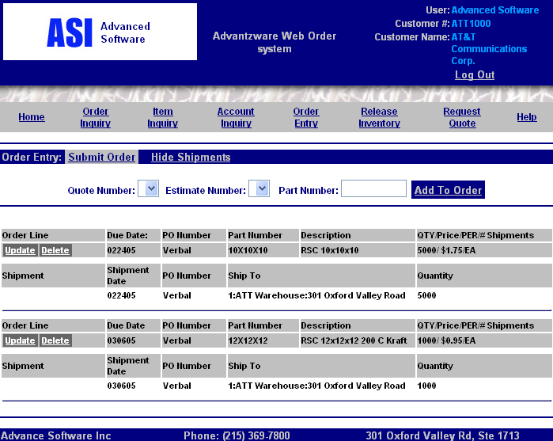
Order Entry Show Shipments
Items are added to the order via the item inquiry or order inquiry screen. Customers may add scheduled deliveries for each part number.

Slide 31
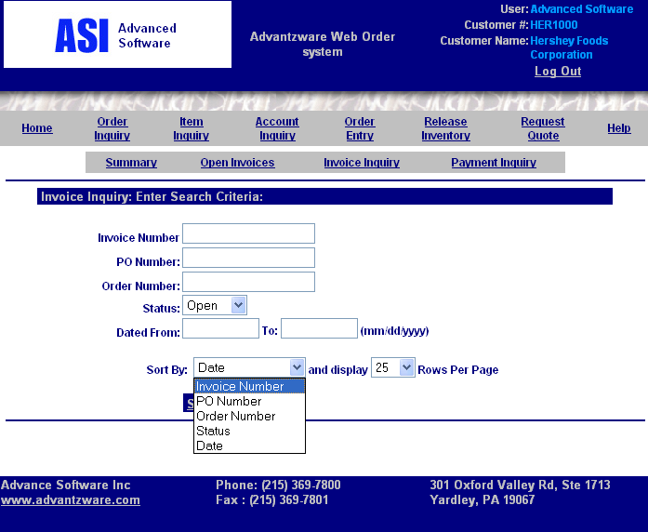
Account Inquiry Invoices
Customer account balances may be sorted by invoice number, purchase order number, order number, order status or date.
Your customer and their branch offices have 24 hour access to their balances.

Slide 32
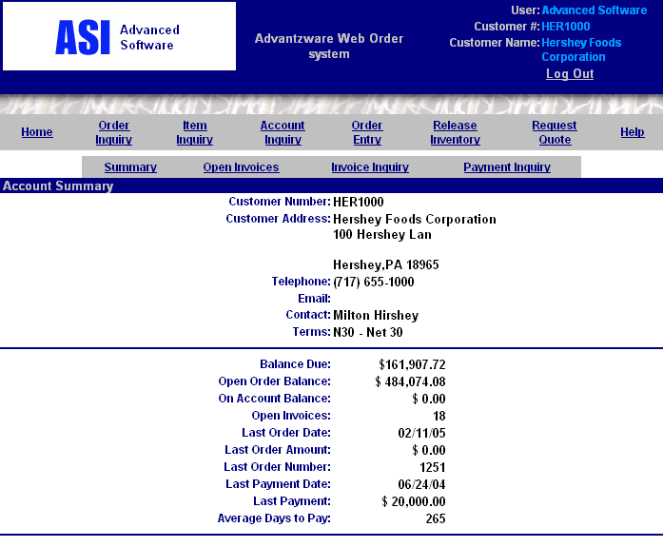
Account Inquiry Summary
Shows customer total balances additional information is available by open invoices, invoices and payments.

Slide 33
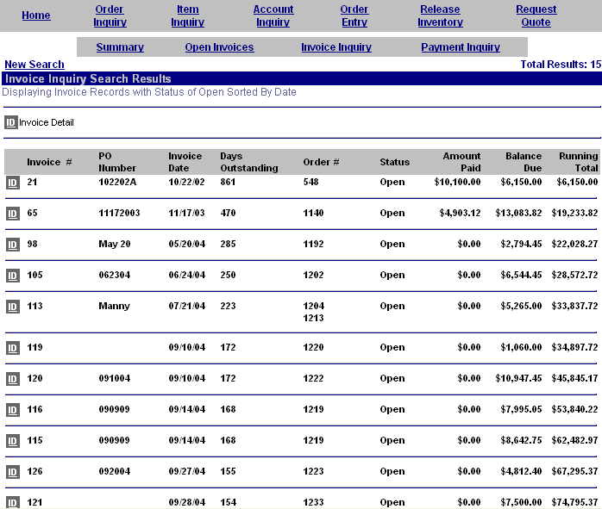
Invoice Inquiry
Details of the invoice benefits your customer plus all their plants and distribution outlets 24 hours a day. Each invoice lists the purchase order number, invoice date, days old, order number, status and balances.
Click the ID invoice detail button to see the line item details.

Slide 34
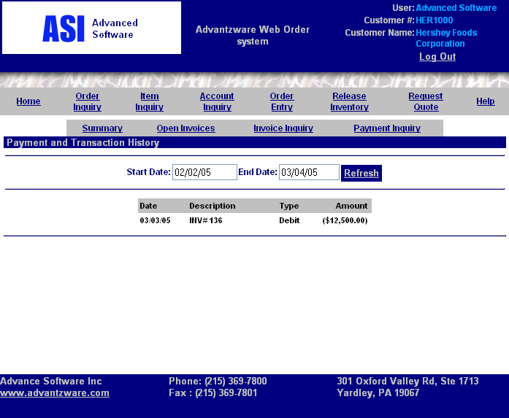
Account Inquiry Payment
Payment may be viewed over a date range.

Slide 35
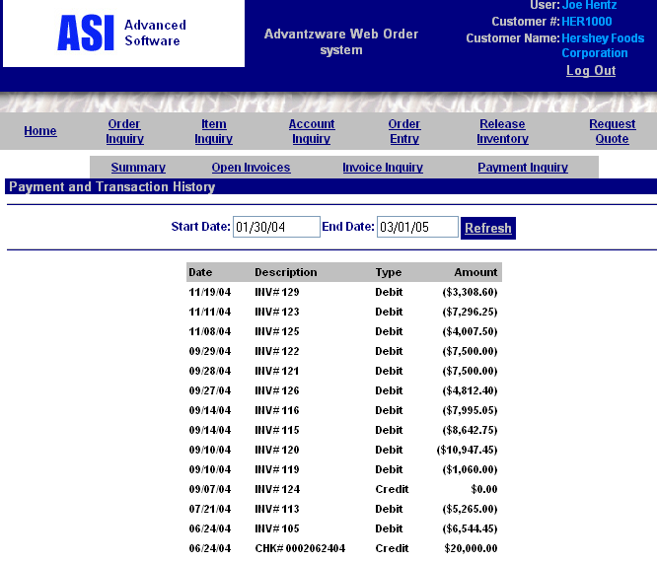
Payment & Transaction History
The customer account inquiry lists all invoices with associated debits and credits.

Slide 36

E-Business – Advantzware
Make e-advantzware your next choice in software.
Real time 24/7 customer service.
Advanced Software
301 Oxford Valley Road, Suite 1713
Yardley, PA 19067
Phone: (215) 369-7800 - Fax: (215) 369-7801
www.advantzware.com
Email: joe@advantzware.com

